Slide 1


Slide 2


Slide 3


Slide 4


Slide 5


Slide 6


Slide 7


Slide 8


Slide 9

Malasia, más de 67 países
800,000,000 USD por año.
Sede Propia
9 Centros de Distribución.

Slide 10


Slide 11


Slide 12


Slide 13


Slide 14


Slide 15
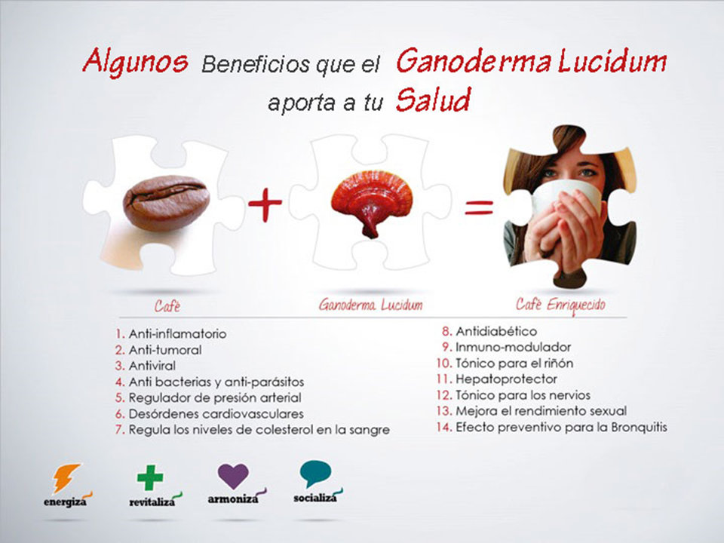

Slide 16


Slide 17


Slide 18


Slide 19

Tu + 2
GEN5
Bono de Inicio Rapido
ESP-1
$200
Level | Left Team | Right Team | Comm. Vol. | Auto Ship | Total C.V. | Pay % | Gen5 Bonus | Commission
1 | 1 | 1 | 100 | 0 | 100 | 15 | $50 | $15
2 | 2 | 2 | 200 | 0 | 200 | 15 | $20 | $30
3 | 4 | 4 | 400 | 0 | 400 | 15 | $40 | $60
4 | 8 | 8 | 800 | 0 | 800 | 15 | $80 | $120
5 | 16 | 16 | 1600 | 80 | 1680 | 15 | $320 | $240
6 | 32 | 32 | 3200 | 160 | 3440 | 15 | 0 | $510
7 | 64 | 64 | 6400 | 320 | 6760 | 15 | 0 | $1005
8 | 128 | 128 | 12800 | 640 | 13500 | 15 | 0 | $2025
9 | 256 | 256 | 25600 | 1280 | 26880 | 15 | 0 | $4020
10 | 512 | 512 | 51200 | 2560 | 53840 | 15 | 0 | $7500
11 | 1024 | 1024 | 102400 | 5480 | 107880 | 15 | 0 | $7500
12 | 2048 | 2048 | 204800 | 10880 | 215680 | 15 | 0 | $7500
Total |  |  |  |  |  |  |  | $31,015

Slide 20

Tus decisiones de hoy...
marcarán la realidad de tu mañana!

